Slide 1
Comp 484 Final Project
By David Kopp

Slide 2
Motivations and Problems
Motivations
Share pictures with family and friends
Allow visitors to download selected files via zip
Problems
Privacy
Customizable

Slide 3
Solution
Personal web server
RaspberryPi 3 – Linux: Raspbian, Nginx, Nodejs, and mysql
Web image gallery
Downloadable option – Zip

Slide 4
Current Functionality
Image browsing
Client-side zipping of files
Canvas theme
Audio

Slide 5
Issues
Ajax
Zipping files on the client-side
Asynchronous methods
Polyfill Compatibility

Slide 6
Future
Learn Nodejs – To zip files, Image lists, and Sessions
Album Login Page – Album Name and password (DB)
Like/Dislike/ROFL/LOL/Embarrassing Buttons
More Themes and Sounds
Client Upload and Configuration Page
Slide Show Option
Video Compatibility
Mobile Configuration
Production Ready

Slide 7
Usability Testing Report
Theme
Ave Score: 9
Colors
Ave Score: 8
Image Sizes
Ave Score: 10
Comments
“Thumbnail images could be smaller.”
“This would be a great way to show friends and family photos on a private site.”

Slide 8
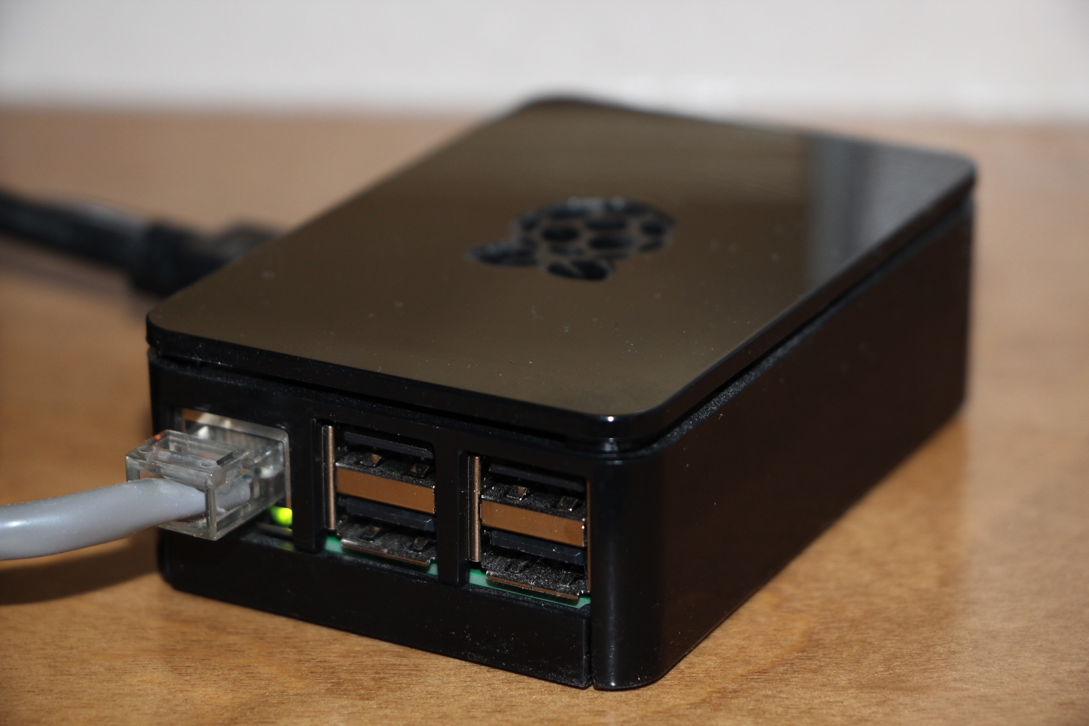
Demo Incoming
http://www.nexusgaming.duckdns.org/gallery/index.html

